Slide 1
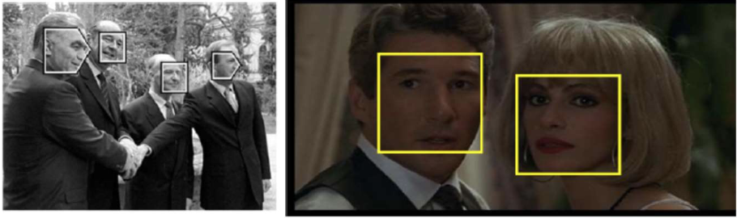

Slide 2
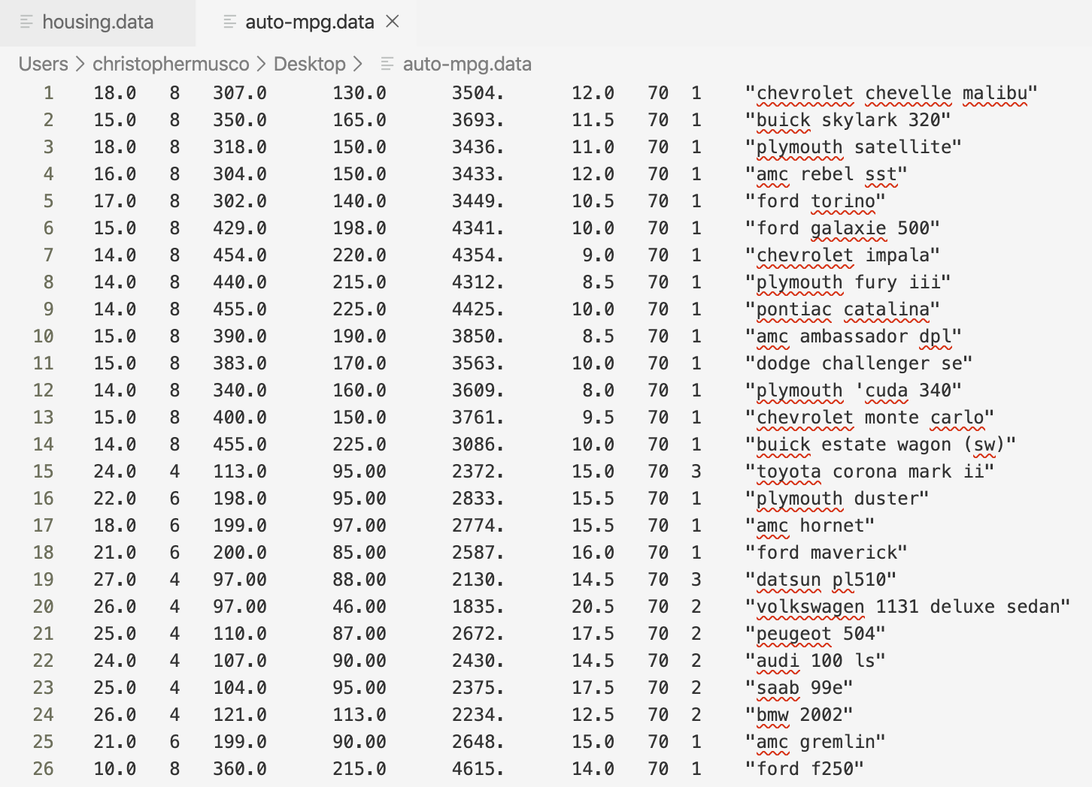
x₁
y₁
c
x₂
y₂
c
c
x₃
y₃

Slide 3
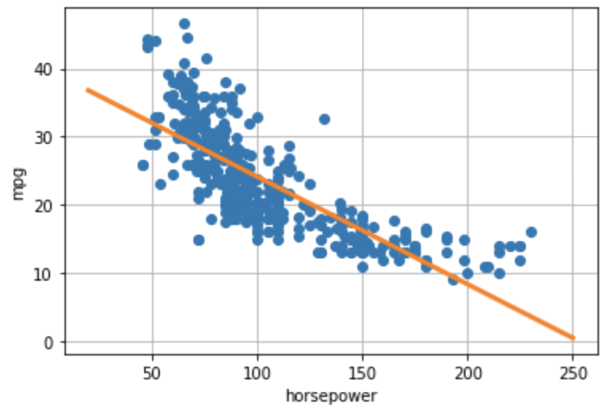
f_{β0, β1}(x)

Slide 4
y_{i} - f_{β0, β1}(x)
f_{β0, β1}(x)

Slide 5
Β₀* + Β₁*x

Slide 6
d features
x₁
y₁
x₂
y₂
n examples
...
...
x_{n}
y_{n}
X
y

Slide 7
~
X
X

Slide 8
d features
1
1
...
n examples
...
age
BMI
sex
1
X

Slide 9
y
x

Slide 10
x
✓
✓

Slide 11
This is a sentence.
1
1
1
1
a
aardvark
zyzzyva
zoo

Slide 12
This is a sentence.
1
1
1
“a sentence”
“is a”
“this is”

Slide 13
This is a sentence.
1
1
“is a sentence”
“this is a”

Slide 14
feature extraction
ML
prediction
1
0
1
1
1
0
0
0
0
0
0
1
1
1
0
0 (safe)
1
0
0
0
1
0
1
0
0
1
0
0
0
0
0
1 (spam)
1
0
0
0
0
1
1
1
0
0
0
0
0
0
0
0 (safe)
1
0
0
0
0
1
0
0
1
0
1
0
0
0
0
0 (safe)
1
0
0
0
1
0
1
0
1
0
0
1
1
0
0
1 (spam)

